Slide 1
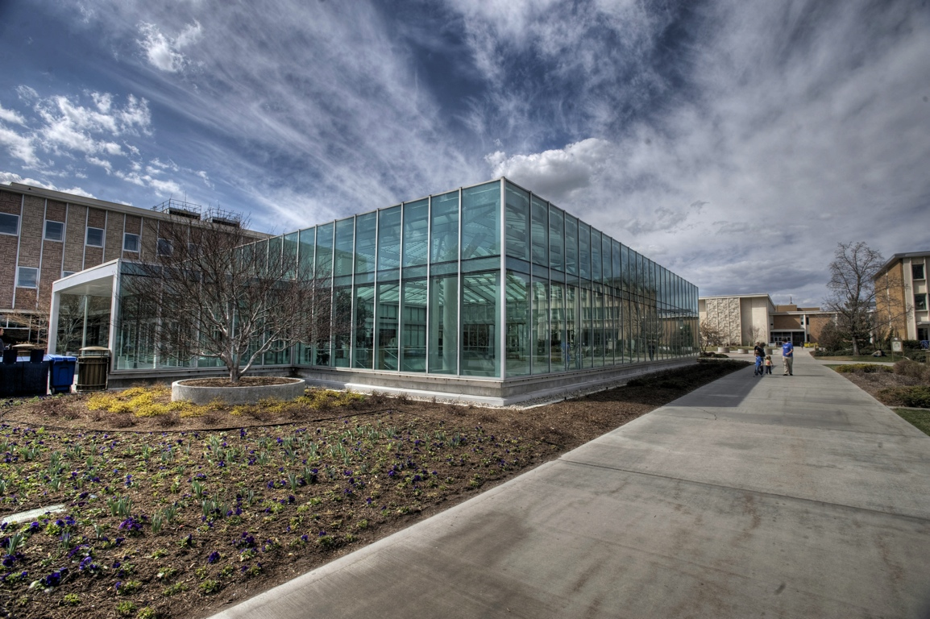
Shelf-ready
Shelf-ready
is it worth the money?
cost-benefit analysis
Rebecca Schroeder
Jared Howland
Notes:
What is shelf-ready?
* When we buy a book, it takes a lot of processing to get it to the shelf for patron use
* Shelf-ready aims to shift that processing from us to our book vendors (in this case, Yankee)
* Instead of spending our time copy cataloging, stamping, barcoding, tattle-taping and labeling books, Yankee will do all of that for us
* There are many potential benefits to shelf-ready
* The purpose of this study was two-fold:
1. Can we better utilize our human resources in cataloging by switching to shelf-ready?
2. Should we move all approval books to be shelf-ready?
http://www.flickr.com/photos/sudweeks/3374587734/sizes/o/

Slide 2
Core steps for cost analysis
Define the item to be costed
Understand the purpose of costing exercise
Determine the cost basis
Gather information on the work process
Identify and quantify the major cost components
Calculate costs
Document your assumptions and perform reasonableness tests
Notes:
“Define the item to be costed”- can be a product, a service, any work activity, also known as “cost objective” establishes the scope of the analysis
Identification of cost components and the calculation of costs “other steps provide context and ensure results are accurate, explainable, repeatable, and achieve desired result”
Understand the purpose of the costing exercise” – clarify the question cost analysis should answer and how information will be used
“Determine the cost basis” – what data is available for the activity to be costed. Should you use actual costs or projected costs (estimates and can be based on historical data)
“Gather information on the activity or work process” – define work involved in detail, step by step description of the work, detail how it will be performed and list resources needed to accomplish the work
Identify and quantify the major cost components” – “costs fall into one of the following categories: supplies and equipment, services, labor, or indirect costs” (Calvi 3)
Expenses can be either direct (those clearly associated with a specific cost object) or indirect (also known as overhead- “common to more than one cost object and are not directly traceable to a specific product” (Calvi 7)
Supplies – “any materials that are consumed in the process of carrying out a particular activity” (Calvi 8) don’t forget to include shipping, staff time in ordering
Equipment – is used over and over again without being substantively consumed” (Calvi 8) “can be incorporated into a cost analysis by amortizing the expenditure over a certain time span and assigning a portion of the equipment’s cost to each item produced during that time”(Calvi 9) “total equipment cost divided by quantity of items produced during its life span = unit cost of equipment” (Calvi 10) exclude multipurpose equipment
Service – meaning outsourcing (vendor charges + shipping, insurance, labor costs, supply and equipment costs, working with vendor, selecting, processing, packing, unpacking, performing quality control (calvi 11)
Labor – If staff performs only the activity being costed and productivity rates are known (divide the staff’s total compensation (salary plus benefits) by quantity of items produced during that time period. In adjusted labor rate method – workers divide their time among a variety of activities – measure time spent on an activity, multiply that time by staff’s compensation rate. To do this first define the activity listing all tasks, determine average completion time
Calculate costs
“Document your assumptions”
“Perform reasonableness tests” – assess the validity of a cost analysis

Slide 3
What we did not measure
Equipment
Space
Staff
Acquisitions processes
Notes:
Does not measure
Equipment: purchase and maintenance of computers, telephones, fax machines, copiers, staplers, tape etc
Space: cost of owning building, maintenance, heat, power, water, toilet paper, soap etc
Staff: interviewing and hiring, training, consultation, non-productive time, mistakes, absenteeism staff development, other assignments
Acquisitions processes: ordering (pre-order searching, order creation
payment – invoices, statement reconciliation, processing payment, library business office, university business office
shipment errors, returns
retaining and maintaining records
Integrated online system - Implementation, initial purchase cost, maintenance and ongoing costs, personnel loading records, orders, invoices.
Processing for payment – create electronic copy in ILS, library business office, university business office cuts check, library business office verifies and mails.

Slide 4
What we did measure
Time
Process
Notes:
What we did measure
Time (from the time the box was opened until book sent to circulation to be put on shelves
Process (followed book through its Technical Service pathway)

Slide 5
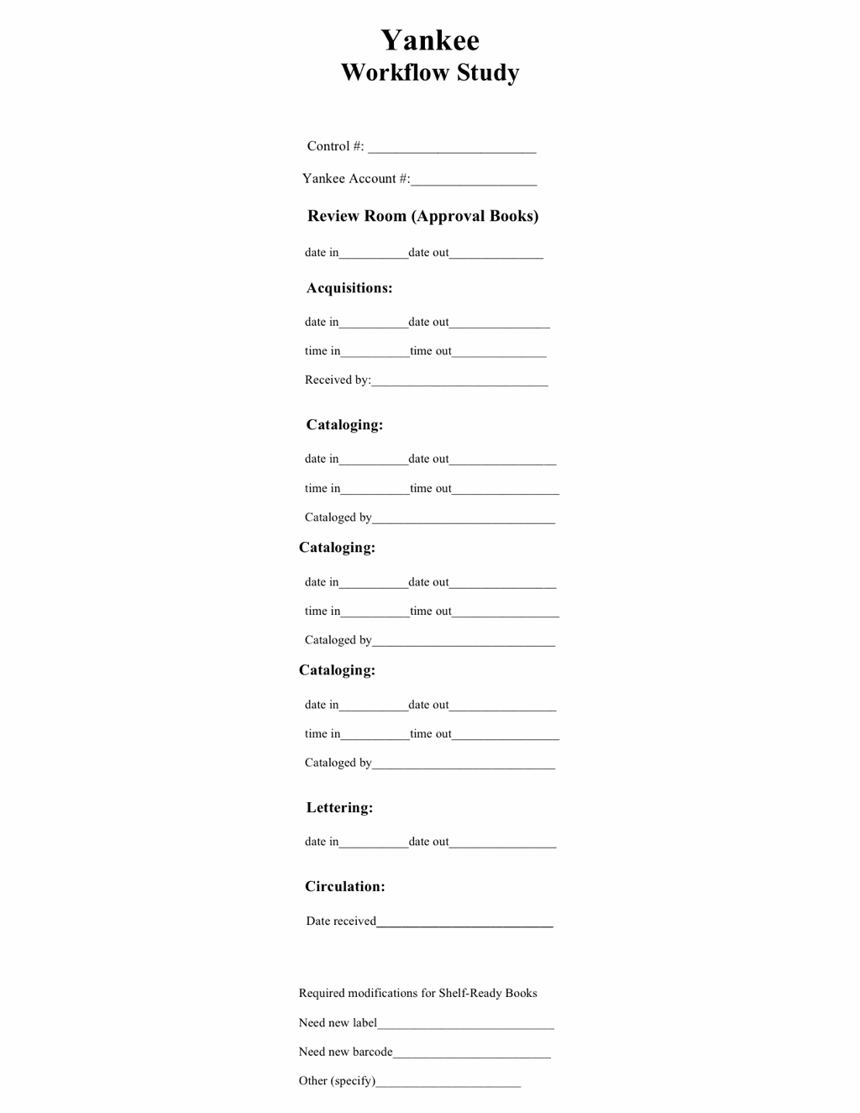
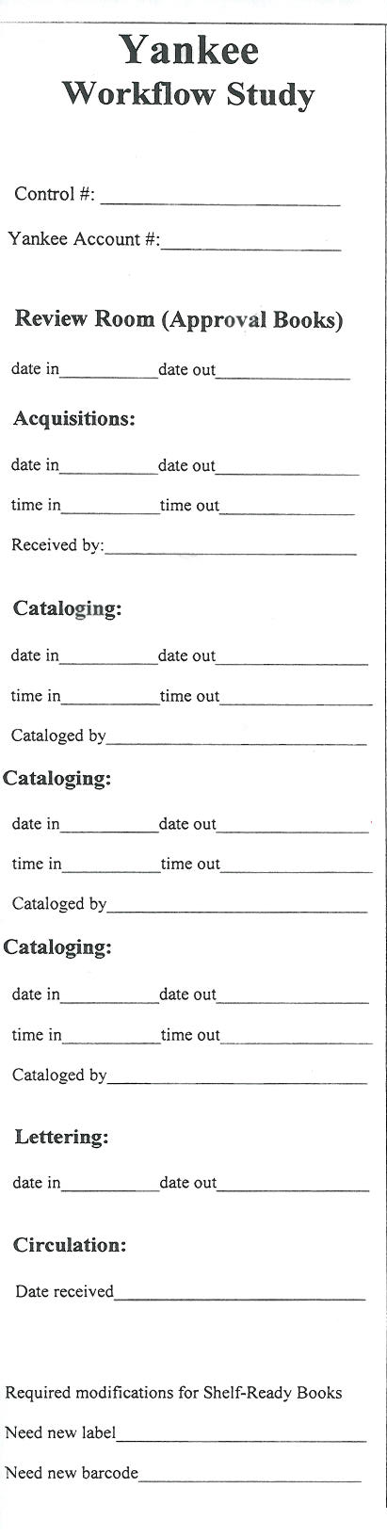

Slide 6
Sub-accounts
ACCOUNT | NAME | TREATMENT
8116-02 | Rush | Nothing
8116-04 | Partial Shelf-ready (Juvenile, Music, Literature) | Bib record, order, physical processing
8116-05 | Special Collections | Bib record, order
8116-07 | Shelf-ready | Bib record, order, physical processing, spine label
8116-10 | Firm Order Exceptions | Nothing
8116-11 | Approval | Bib record, order
8116-13 | Continuations | Nothing
Notes:
Have 7 sub-accounts depending on the way books are sent and the level of processing
02-none -Rush
04-Bib record, order, physical processing (JUV, MUSIC< Literature (P Call #)
05-Bib record and order (Special Collections)
07-Bib record, order, physical processing, spine label (Shelf-ready)
10-none, exceptions another volume in set, replacement
11-Bib record, order, invoice (Approval)
13-none (continuations)

Slide 7
Approval Process
Notes:
Traditional path - Firm order, Continuations, Special Collections, Rush - these follow mostly the same path

Slide 8
Previous Shelf-ready process

Slide 9
Current Shelf-ready Process

Slide 11
Cost Comparison
Cataloging Salaries
_______________________________
Number of Books Cataloged
= $47.64

Slide 12
Cost Comparison (2/23/2010)
Account | Total Average Cost | Acquisitions Cost | Cataloging Cost | Sample Size
Rush Order | $8.65 | $0.73 | $5.08 | 3
Partial Shelf-ready | $3.60 | $0.31 | $1.86 | 14
Shelf-ready | $3.18 | $0.42 | $0.83 | 186
Firm-order | $7.12 | $1.34 | $2.69 | 16
Approval | $5.60 | $0.31 | $2.09 | 1,214
Continuations | $7.58 | $1.92 | $2.26 | 26

Slide 13
Cost Comparison (+$1.10 for MARC on shelf-ready)
Account | Total Average Cost | Acquisitions Cost | Cataloging Cost | Sample Size
Rush Order | $8.65 | $0.73 | $5.08 | 3
Partial Shelf-ready | $5.60 | $0.31 | $1.86 | 14
Shelf-ready | $5.18 | $0.42 | $0.83 | 186
Firm-order | $7.12 | $1.34 | $2.69 | 16
Approval | $5.60 | $0.31 | $2.09 | 1,214
Continuations | $7.58 | $1.92 | $2.26 | 26

Slide 14
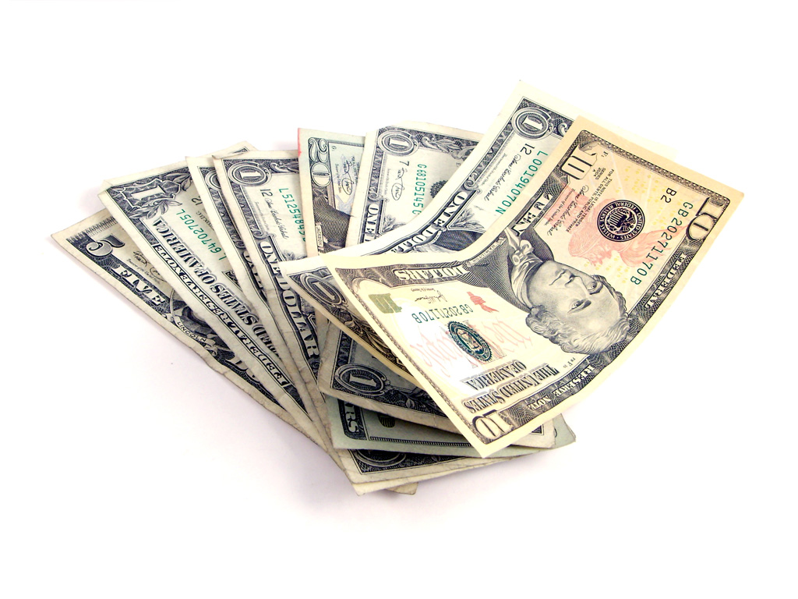
7.5%
cost savings
5.7%
cost savings
Notes:
$5.28 per book vs $5.60 per book (salary, processing, materials etc)

Slide 15
Cost Comparison
Account | Total Average Cost | Acquisitions Cost | Cataloging Cost | Sample Size
Rush Order | $8.65 | $0.73 | $5.08 | 3
Partial Shelf-ready | $5.60 | $0.31 | $1.86 | 14
Shelf-ready | $5.28 | $0.42 | $0.83 | 186
Firm-order | $7.12 | $1.34 | $2.69 | 16
Approval | $5.60 | $0.31 | $2.09 | 1,214
Continuations | $7.58 | $1.92 | $2.26 | 26

Slide 16

90%
decreased time to shelf
Notes:
3.59 days per book for shelf-ready vs. 36.66 days per book for approval
Patrons get access to books 33 days sooner

Slide 17
Days Comparison
Account | Average Days in Acquisitions | Average Days in Cataloging | Average Days in Lettering | Average Days From Receiving to Circulation
Rush Order | 0.00 | 0.67 | 0.00 | 0.67
Partial Shelf-ready | 0.00 | 9.85 | 3.29 | 12.86
Shelf-ready | 0.27 | 6.22 | 0.74 | 3.59
Firm-order | 0.00 | 19.81 | 9.64 | 24.10
Approval | 0.10 | 11.67 | 8.68 | 36.66
Continuations | 0.00 | 9.45 | 10.08 | 23.50

Slide 18
Days Comparison
Over
90%
speed increase

Slide 19

47%
less processing time
47%
less processing time
Notes:
5:06 per book for shelf-ready vs. 9:59 per book for approval

Slide 20
Time Comparison
Account | Average Processing Time in Acquisitions | Average Processing Time in Cataloging | TOTAL AVERAGE
Rush Order | 4:00 | 12:00 | 16:00
Partial Shelf-ready | 2:09 | 4:40 | 6:50
Shelf-ready | 3:24 | 4:53 | 5:06
Firm-order | 9:35 | 17:11 | 26:45
Approval | 2:15 | 7:42 | 9:59
Continuations | 4:02 | 8:32 | 12:32

Slide 21
Time Comparison
Over
47%
less processing time

